Slide 1
Amy Brower, PhD

Slide 2
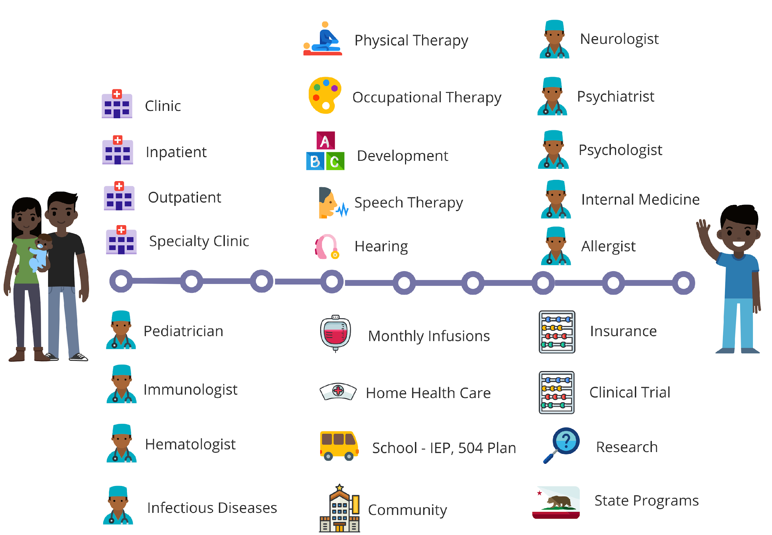
The Potential of the Newborn Screening System
A national and state-based LTFU system that supports the NBS community
Enable state NBS programs to coordinated LTFU care through a medical home
Guide improvements in screening, diagnosis, care, and management of all newborns
Accelerate understanding of the conditions that are part of or candidates for NBS
Leverages the unique features of screening not being based on access, geography, socioeconomic status or other factors

Slide 3
Key Goals of Efforts to Develop Comprehensive Models of LTFU
Collaborations between clinicians, public health agencies, and families
Implement LTFU model protocols and data collection
Demonstrate integration of LTFU model data from clinical and public health systems
Increase the number of families who receive coordinated LTFU care through a medical home consistent with the LTFU model

Slide 4
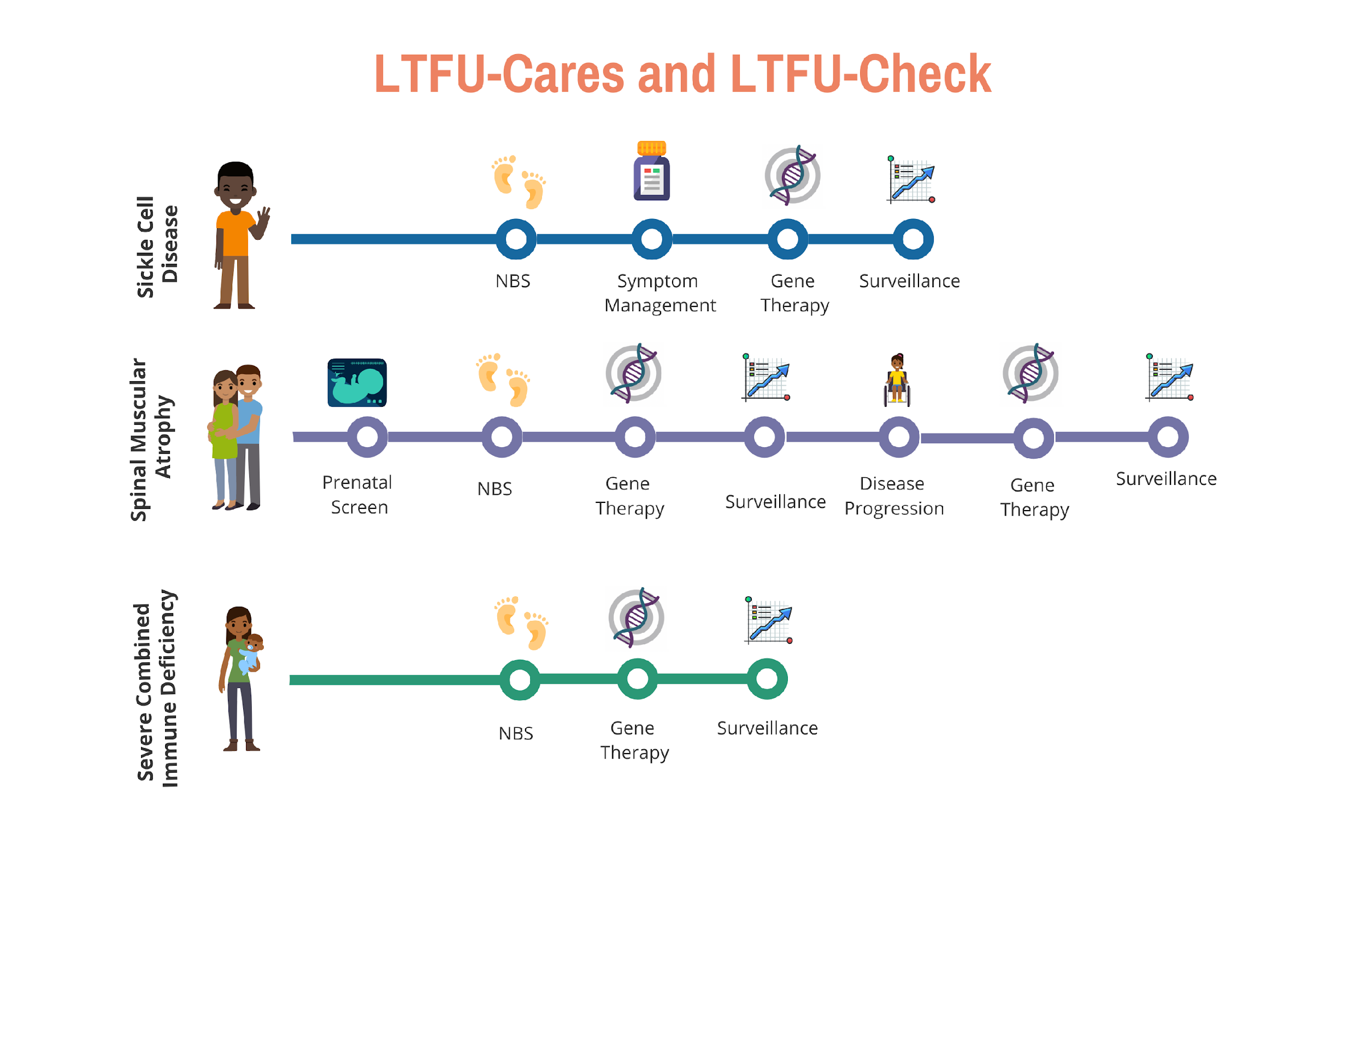
ACMG LTFU-Cares and LTFU-Check Initiative
A longitudinal care, data tracking and reporting system designed by and for all NBS stakeholders
Notes:
ACMG received a grant from HRSA

Slide 5
Our Goal is to Develop a Comprehensive LTFU Model System

Slide 6
Our Focus is on Spinal Muscular Atrophy (SMA)
Recommended for nationwide NBS screening in July 2018

Slide 7
Our Project Includes a Focus on Parents and Families
Medical Home
Health
Outcomes
Care Coordination
Notes:
All stakeholders in NBS including parents, families, advocacy groups, healthcare professionals, researchers, and state NBS programs play important roles in LTFU. Our project includes an innovative approach based on computational social choice theory to assess families’ needs. We are engaging families with NBS identified SMA to tell identify and prioritize which data points are helpful to inform an assessment of medical home, health outcomes, and care coordination.

Slide 8
Our Project Recruited Experts in Clinical Care
Notes:
All stakeholders in NBS including parents, families, advocacy groups, healthcare professionals, researchers, and state NBS programs play important roles in LTFU. Our project includes an innovative approach based on computational social choice theory to assess families’ needs. We are engaging families with NBS identified SMA to tell identify and prioritize which data points are helpful to inform an assessment of medical home, health outcomes, and care coordination.

Slide 9
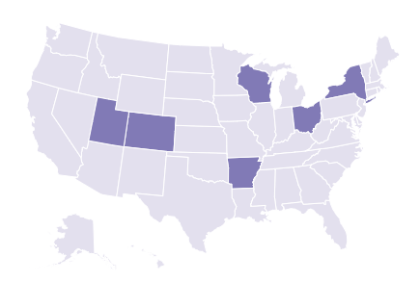
We will offer LTFU-Check and LTFU-Cares Dashboard to State NBS Programs
550K annual births
14% of annual US births
Estimate 100 newborns with SMA identified each year
~4 years of screening
USA
LTFU Cares
Notes:
All stakeholders in NBS including parents, families, advocacy groups, healthcare professionals, researchers, and state NBS programs play important roles in LTFU. Our project includes an innovative approach based on computational social choice theory to assess families’ needs. We are engaging families with NBS identified SMA to tell identify and prioritize which data points are helpful to inform an assessment of medical home, health outcomes, and care coordination.

Slide 10
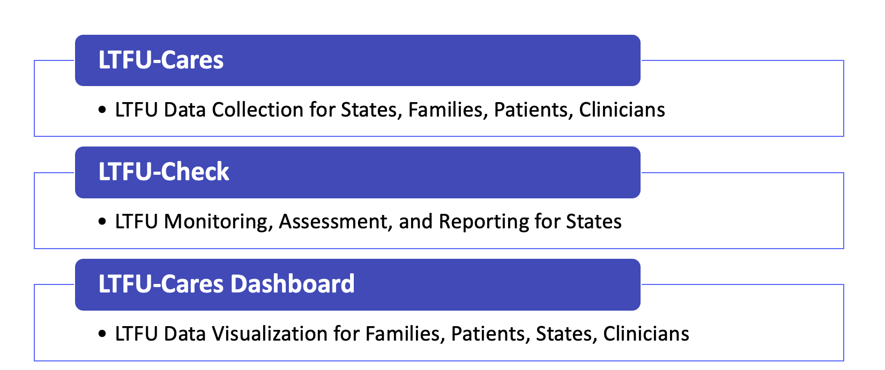
Our Project Supports State NBS Programs in LTFU in Newborn Screening
USA
LTFU Cares
550K annual births
14% of annual US births
Estimate 100 newborns with SMA identified each year
~4 years of screening
Notes:
All stakeholders in NBS including parents, families, advocacy groups, healthcare professionals, researchers, and state NBS programs play important roles in LTFU. Our project includes an innovative approach based on computational social choice theory to assess families’ needs. We are engaging families with NBS identified SMA to tell identify and prioritize which data points are helpful to inform an assessment of medical home, health outcomes, and care coordination.

Slide 11
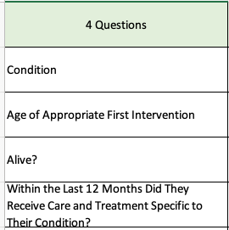
State NBS LTFU

Slide 12
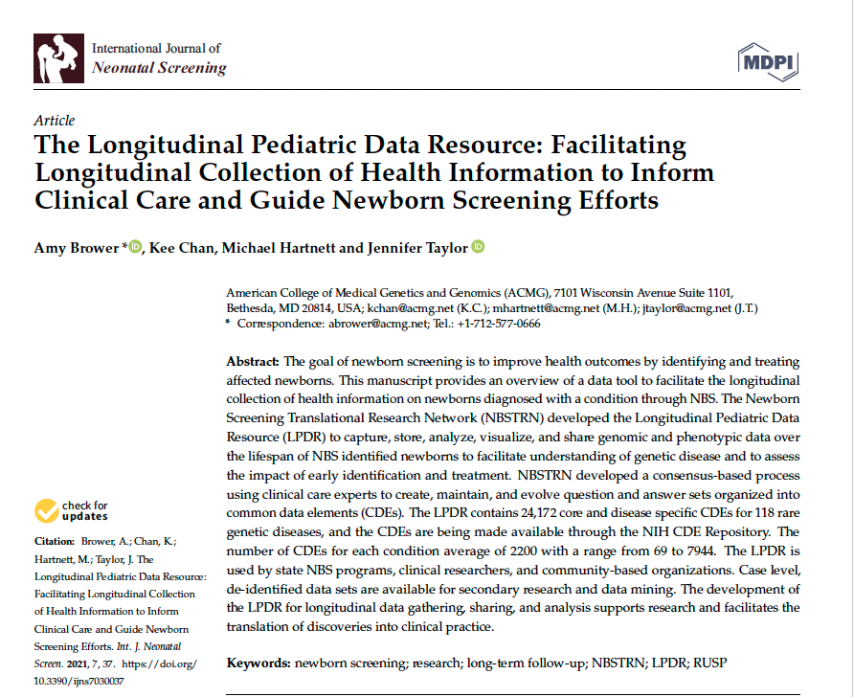
We are expanding previous efforts to include parents and families.
Add parent-controlled sharing of data from electronic medical records
Analyze and visualize data collected from different data for LTFU-Cares Dashboard development
Disseminate LTFU-Cares Dashboard to state NBS, clinicians, and families
Disseminate LTFU-Check to state NBS
Develop educational materials for families
Provide opportunity for families to share prospective data outside of this effort
https://www.mdpi.com/1170934
Notes:
All stakeholders in NBS including parents, families, advocacy groups, healthcare professionals, researchers, and state NBS programs play important roles in LTFU. Our project includes an innovative approach based on computational social choice theory to assess families’ needs. We are engaging families with NBS identified SMA to tell identify and prioritize which data points are helpful to inform an assessment of medical home, health outcomes, and care coordination.

Slide 13
Our Data Workflows Support LTFU, Care Coordination, and Reporting for All Three Stakeholder Groups

Slide 14
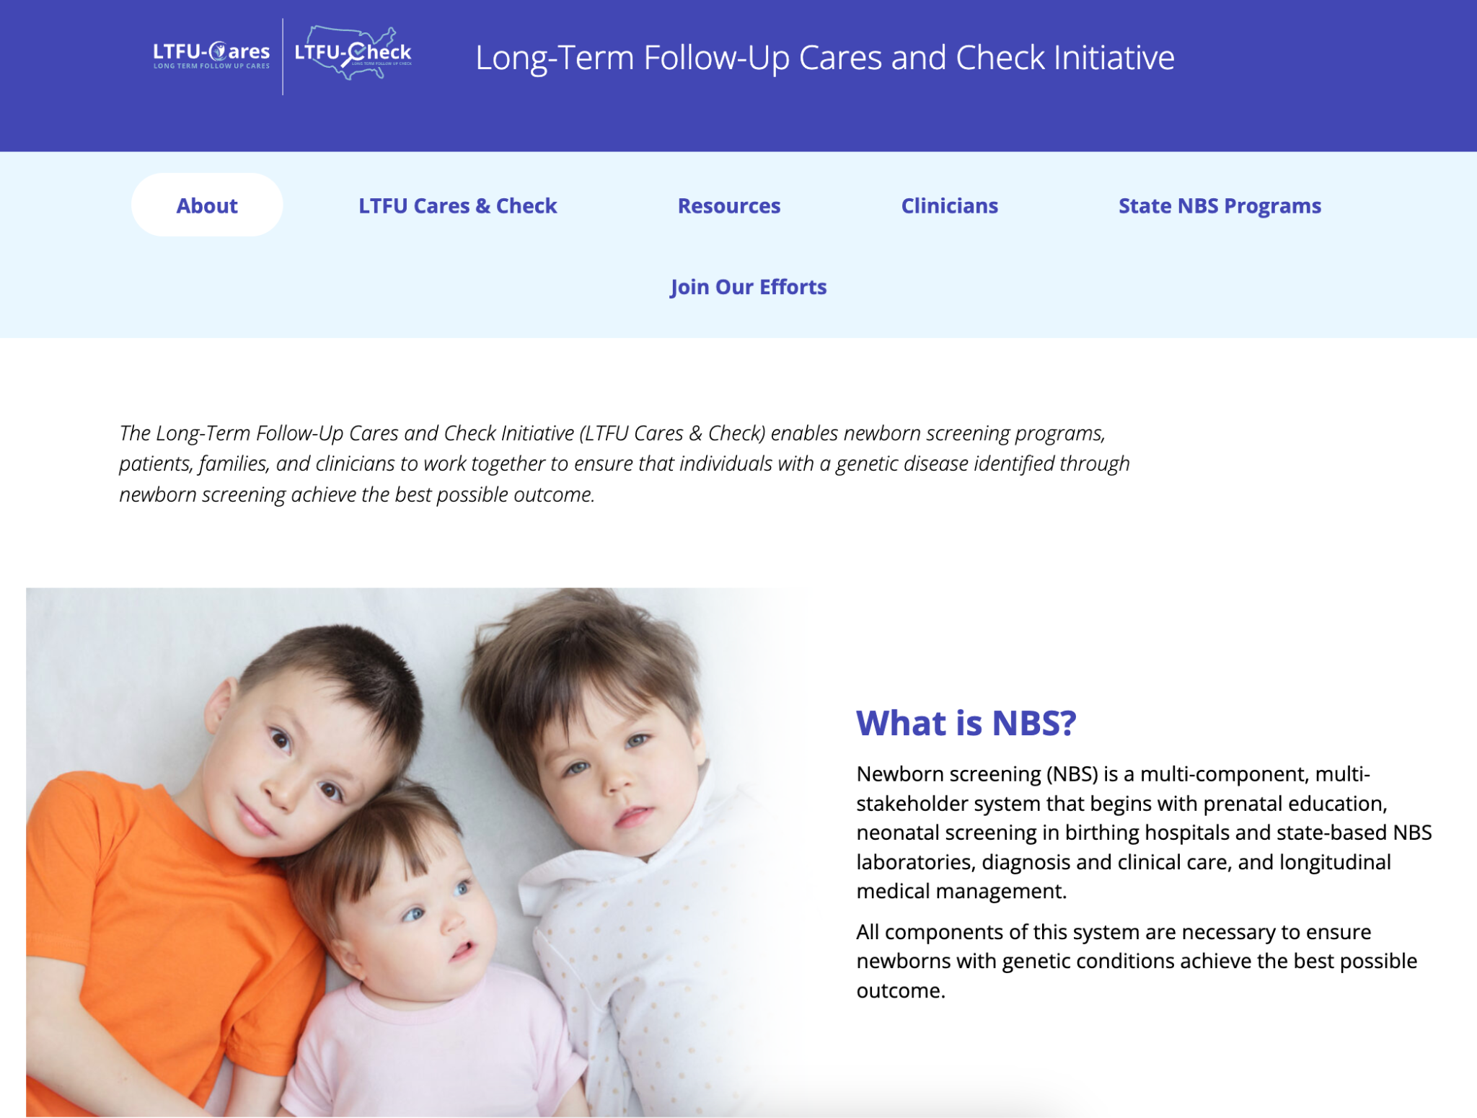
longtermfollowupnbs.org

Slide 15
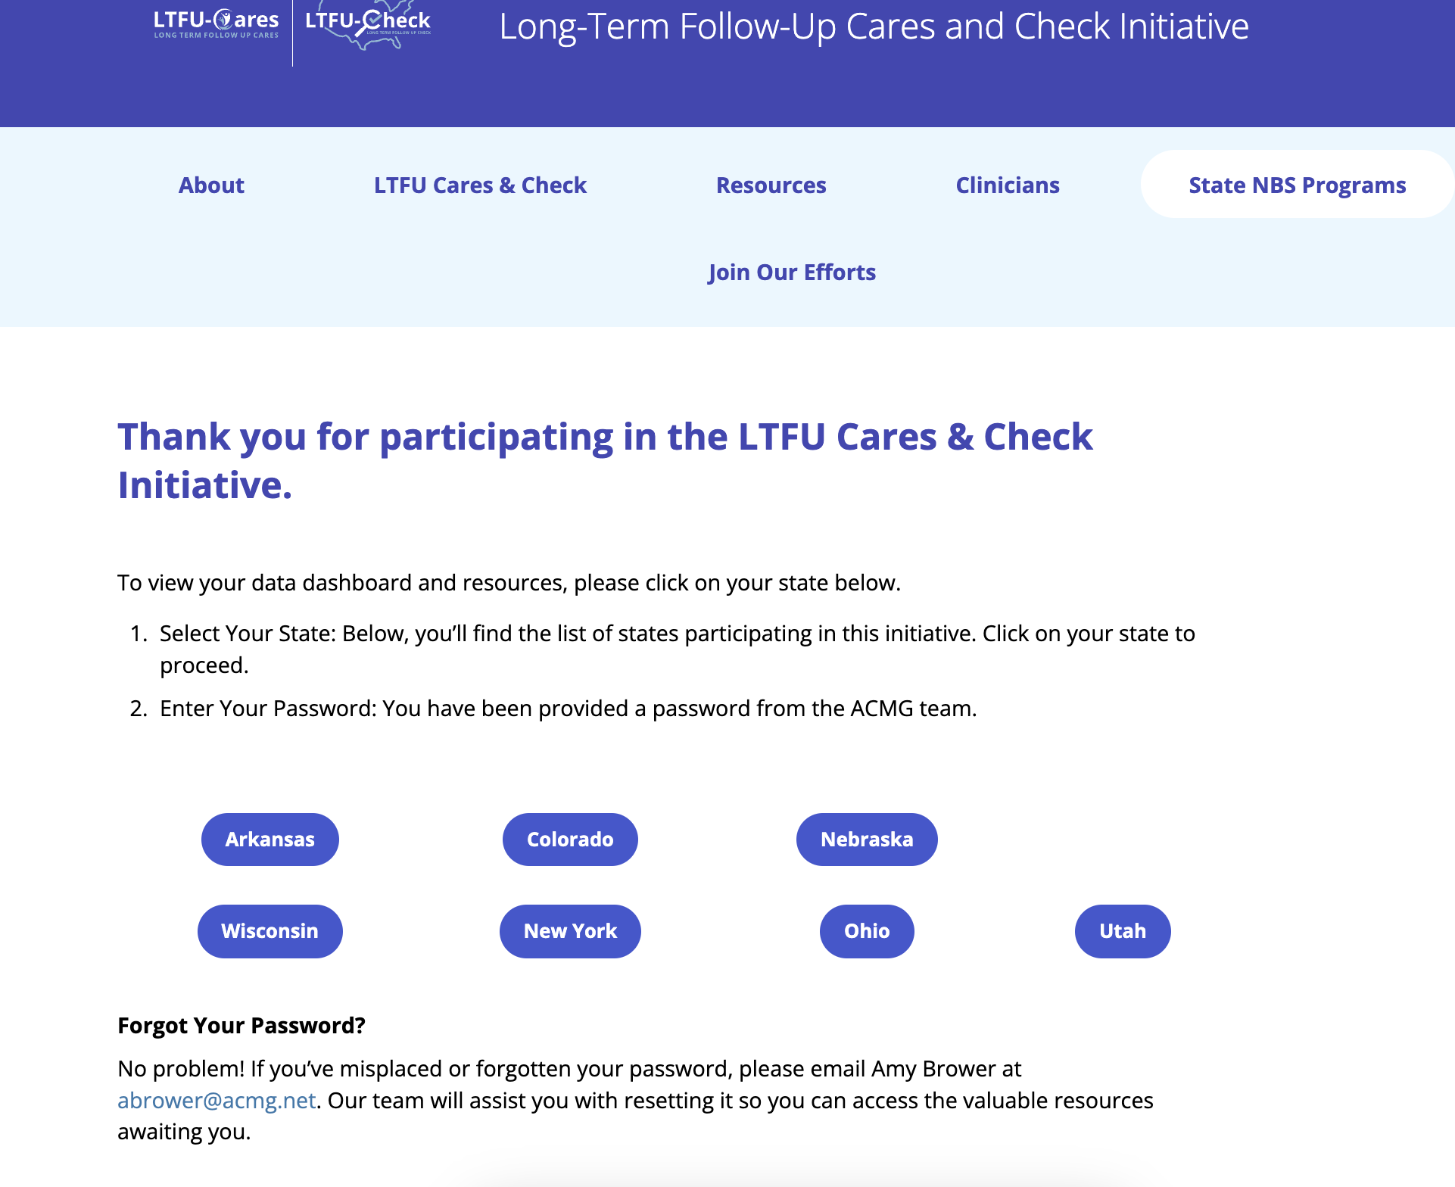
LTFU-Cares Dashboards for States and Clinicians
Participating states and clinicians can access their dashboards, data, and additional tools on our website.
Our dashboards feature data prioritized by families first and then clinicians.

Slide 16
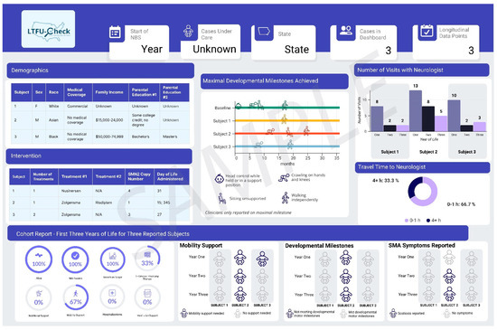
Clinical dashboards feature case-level data.

Slide 17
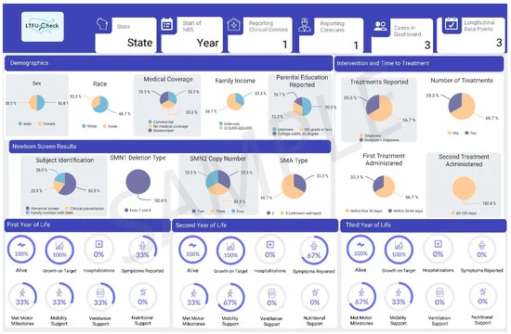
State dashboards feature annual data.

Slide 18
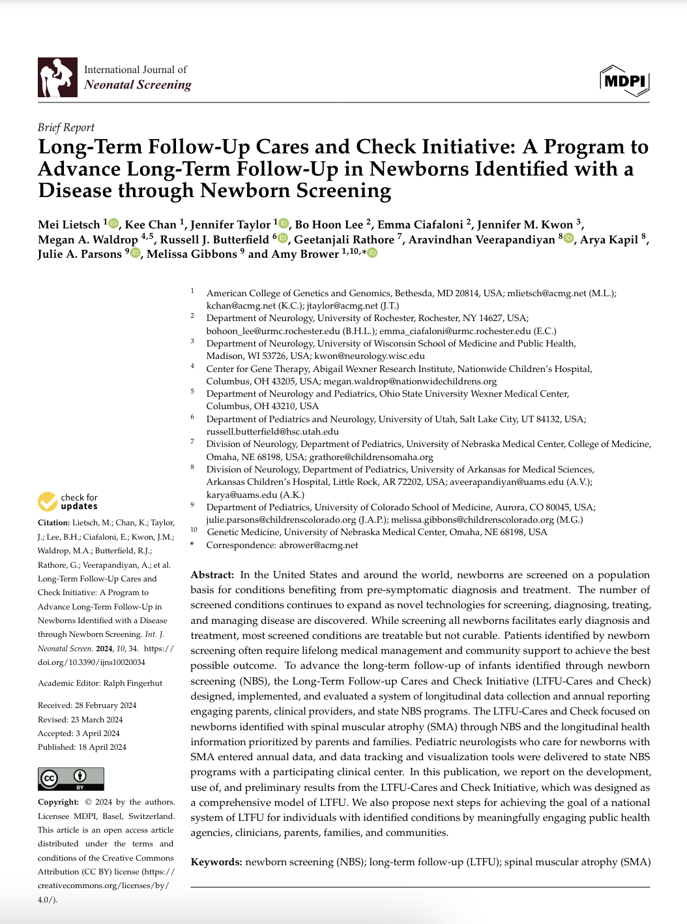
For additional information, please read our methodology paper outlining in detail the process behind each tool, the dissemination strategy, and the LTFU-Cares Dashboard, which features key outcomes prioritized by parents and clinicians.
To view the full text: https://doi.org/10.3390/ijns10020034

Slide 19
Follow LTFU-Cares and LTFU-Check Initiative
on Social Media
Facebook Group at LTFUCares
LinkedIn LTFUCares
Instagram @ at LTFUCares
Twitter @LTFUCares

Slide 21
Acknowledgment

