Slide 1
Putting Families First: Innovative Approaches of Long-Term Follow-Up Cares and Check Initiative (LTFU-Cares & Check)
Kee Chan, Natasha F. Bonhomme, Jennifer Taylor, Yekaterina Unnikumaran, Ian F. Terry, Sharon F. Terry, Amy Brower

Slide 2
Disclosures
I have no financial disclosures.

Slide 3
The goal is to make available funding to support comprehensive models of long-term follow-up (LTFU) that demonstrate collaborations between clinicians, public health agencies, and families.
Six recipients were funded for 2 years to support comprehensive models of long-term follow-up (LTFU).
Objectives:
- implement LTFU model protocols and data collection with at least five clinical sites.
- demonstrate integration of LTFU model data from clinical and public health systems
- increase the number of families who receive coordinated LTFU care through a medical home consistent with the LTFU model
Cristina Novoa, PhD, MPP
Division of Services for Children with Special Health Needs Genetic Services Branch
Maternal and Child Health Bureau (MCHB)
Notes:
Refer to the Abstract

Slide 4
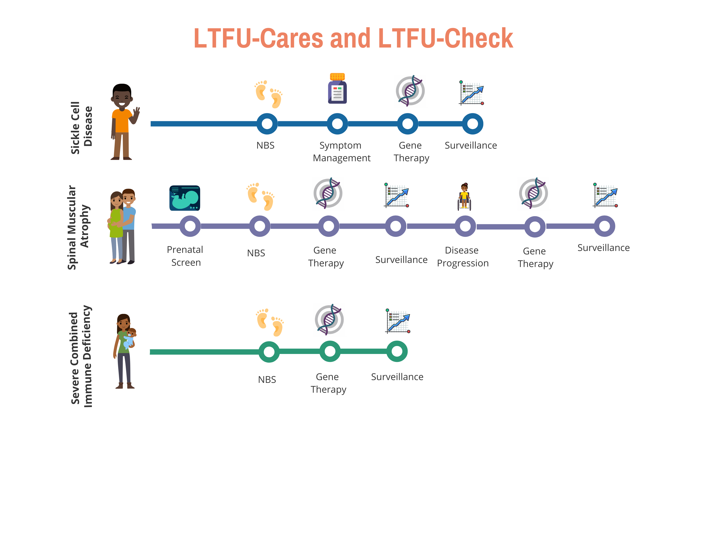
LTFU-Cares and LTFU-Check Initiative
A longitudinal care, data tracking and reporting system designed by and for all NBS stakeholders
Notes:
ACMG received a grant from HRSA

Slide 5
SMA as a model condition chosen for several reasons
Variable phenotypes
Prenatal onset
Carrier screening
Gene-targeted therapies
Clinical care network
Expansion of LPDR to support LTFU care and outcomes reporting by developing and implementing:
Tools
LTFU Care Algorithms (LTFU-Cares) = data collection based on algorithms
LTFU-Cares Checklist (LTFU-Check) = state NBS report
LTFU-Cares Dashboard = data entered by stakeholders and visualized back to them

Slide 6
Our Project Includes a Focus on Parents and Families
Medical Home
Health
Outcomes
Care Coordination
Notes:
All stakeholders in NBS including parents, families, advocacy groups, healthcare professionals, researchers, and state NBS programs play important roles in LTFU. Our project includes an innovative approach based on computational social choice theory to assess families’ needs. We are engaging families with NBS identified SMA to tell identify and prioritize which data points are helpful to inform an assessment of medical home, health outcomes, and care coordination.

Slide 7
LTFU-Cares and LTFU-Check Initiative
Research
Public Health
Translation
Clinical Care
Patients &
Families
Data Collection and Engagement Since 2011
Cure SMA (N = 701); SPOT SMA (N = 434)
NBSTRN
Genetic Alliance and LunaDNA will lead an effort to Identify and Prioritize Surrogate Measures of Success
ACMG
Dr. Ciafaloni & 5 clinical sites will implement tools.
Engagement & Implementation in Selected State Public Health Agencies
Cure SMA Chapters (N = 36),
Care Registry (N >= 600), Member Database (120,000)

Slide 8
Tools and Key Features That Will Be Developed
LTFU-Cares
LTFU-Check
LTFU-Cares Dashboard
LTFU Data Collection for States, Families, Patients, Clinicians
LTFU Monitoring, Assessment, and Reporting for States
LTFU Data Visualization for Families, Patients, States, Clinicians

Slide 9
LTFU-Cares
Cure SMA
SPOT SMA
Core
LTFU-Cares
Disease-specific question and answers
Patient and family perspectives
Clinician perspectives
Includes recommended therapies, interventions, and management approaches for each state of life and disease
Data Collection by state public health agencies, clinicians, and families to enroll, track, and report on newborns and children with NBS condition.
LunaDNA
List of CDEs

Slide 10
LTFU-Check
Cure SMA
SPOT SMA
Core
LTFU-Cares
Web-based tool designed for state public health agencies
State NBS Programs
Other Departments and/or Divisions
Enables monitoring, assessment, and reporting on LTFU care and outcomes at both the case- and state-level
Ability to report on the extent NBS achieves the long-term goals of improved health, growth, development, and function.
LTFU-Check

Slide 11
LTFU-Cares Dashboard
Cure SMA
SPOT SMA
Core
LTFU-Cares
Web-based, permission-based data visualization tool designed for all stakeholders
Enables access to LTFU outcomes
Customizable views
LTFU-Cares Dashboard
Levels
National
State
Community
Clinic
Family
Population
Aggregate
Disease-specific
Community-specific
Individual
Users
Patient
Family
Clinician
State

Slide 12
Engaging Patients, Families, & Advocacy Organizations
Identifying the health information important to families
Using a human-centered approach based on computational social choice theory to assess families’ needs
Partnering with Genetic Alliance and LunaDNA on platform using proprietary software to produce the top 5 themes important to SMA families
Notes:
Setting the purpose - the stage of working with families.

Slide 13
Methods
Activity 1: “Discovery Conversations” with a few pre-selected individuals.
Interviews with 4 SMA families identified through newborn screening
Activity 2: Identification of the themes relevant to SMA patients.
Word frequency analysis using LunaDNA’s proprietary software
Keyword search through SMA literature
Input from project team on the topics and concepts about NBS and LTFU
Activity 3: Prioritization of top 5 themes using user preferences with additional families.

Slide 14
100 Themes Important to SMA Families about LTFU
Gene Therapy
Time to Initial Treatment
SMA Type
# of Backup Copies
Physical Therapy
Shoes
Coverage by Insurance
Muscle Tone Management
Local Pediatrician
Child's Growth
Neurologist
Cost of Treatment
Acid Reflux
Tongue Tie
Leg Braces
Development Timing
Pulmonary
Genentech Foundation
Sleep Apnea
Speech Therapy
Sleep Quality
Diet
Homeopathic remedies
Early Symptoms (Lack of, information of what they are)
Resources for Siblings
Equipment Access
Streamlining of care team
Stress of being primary care
Information being conveyed in plain language
Presence of Safety Net
Information on different types of care available
Experience traveling for care
# of appointments
Cadence of ongoing medical treatment
Support evolving to adjust to changing needs
Proactive Support
Celebrating the successes
Stress of constant meetings
Improved Outcomes
Communication to Follow-up Task Froce
Time-bound care updates (monthly, yearly)
Consistency of contact with care team
Improving outcomes for future families
Information before screening is done
Method of delivery of screening results
Availability of Newborn Screening
Locational impact on newborn screening
Quality of Pediatrician (bedside manner, condition knowledge)
Conditions Covered By Screening (Lack of, or reason for)
Information while still at the hospital
Blood Test
Pulse Oximetry
Hearing Test
Length of time to receive additional care
Age of first supportive treatment
Age at first curative treatment
Support given at screening results
Support given at diagnosis
Support given at execution of screening
Acclimation support for life changes
Education Support (IEP, accessibility)
Patterns in Condition (weeks, months, years)
Telehealth
Information on Vaccines (COVID, other)
Support of Caregiver time for self-care
Societal Awareness Support
Marital Stress (additional stress, conflict)
Long-term Data (Storage, collection, usage)
Ethics of Long-term follow up
Accuracy of Screening
Accuracy of Diagnostic Test
Hospitalization
Coordination between care team
Clinical Trials and Studies
Shoes
Muscle Tone Management
Tongue Tie
Stress of Being Primary Care
Mobility (issues, progression)
Mutation Specific Information
Community (support, interaction, connection)
Birthing Difficulties (mother, child, NICU)
First moment of symptoms
Pregnancy (pre, per, and post-natal)
Difficulty Eating
Difficulty Swallowing
Prognosis (long term, specific)
Quality of Life (improvements, current state)
Weakness in body
Assistive Technology
Primary Care Provider
Communication between care team
Assistance with Insurance
Resources to learn about specific condition
Resources to help set expectations
Genetic Counseling
Over-reliance on specific doctor
Palliative Care
Size of home town
Assistance transitioning to caregiving
Cohesiveness of Care
Travel Expenses
Long-term Care

Slide 15
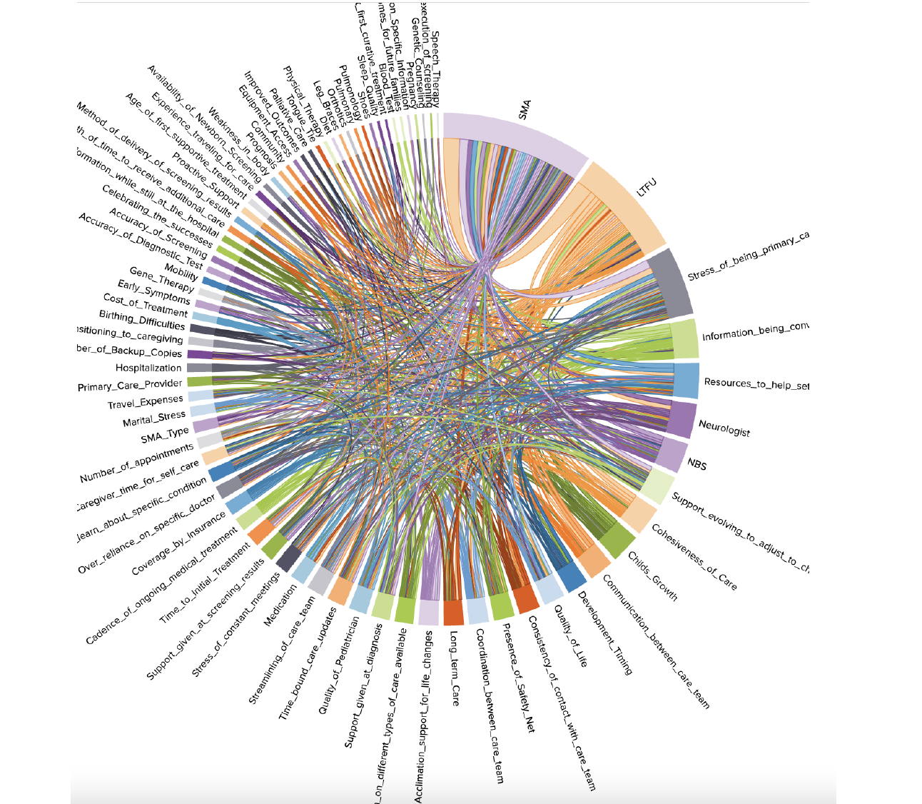
Preliminary Results: Example
SMA
LTFU
Chord diagrams were used to visualize the cross-section of SMA and LTFU and the interconnection with other topics
The width of the region represent that this keywords were more frequently identified in the interview compared to others.
The connection from one region to another region represents “how two themes” were connected in the conversation.
NBS
Notes:
These topics were elicited out of interviews with SMA families, the input of members of ACMG,
and the evaluation of existing publications and citations around the keywords generated from
the other two groups. These topics were then analyzed for their ability to “frame” the given
space of the cross-section of Long-term follow-up, newborn screening, and life with SMA.
Their interconnections were studied using what are called “chord diagrams” which are used to
visually represent the entire space on a 2D plane. Below is one such chord diagram showing the
interconnection of the topic areas for one of the families.

Slide 16
Next Steps
Recruit families to the third activity by working with advocacy organizations (such as CureSMA, NORD, etc.)
Prioritize the themes using user preferences with 20 families on the LunaDNA platform.
Use information to adapt project tools:
Adaptation to the LTFU-Cares tool to highlight data collection for the to 5 prioritized themes
Development of resources for recommended therapies, interventions, and management approaches for each stage of life and disease, as well as outcomes of interest to parents and families.

Slide 17
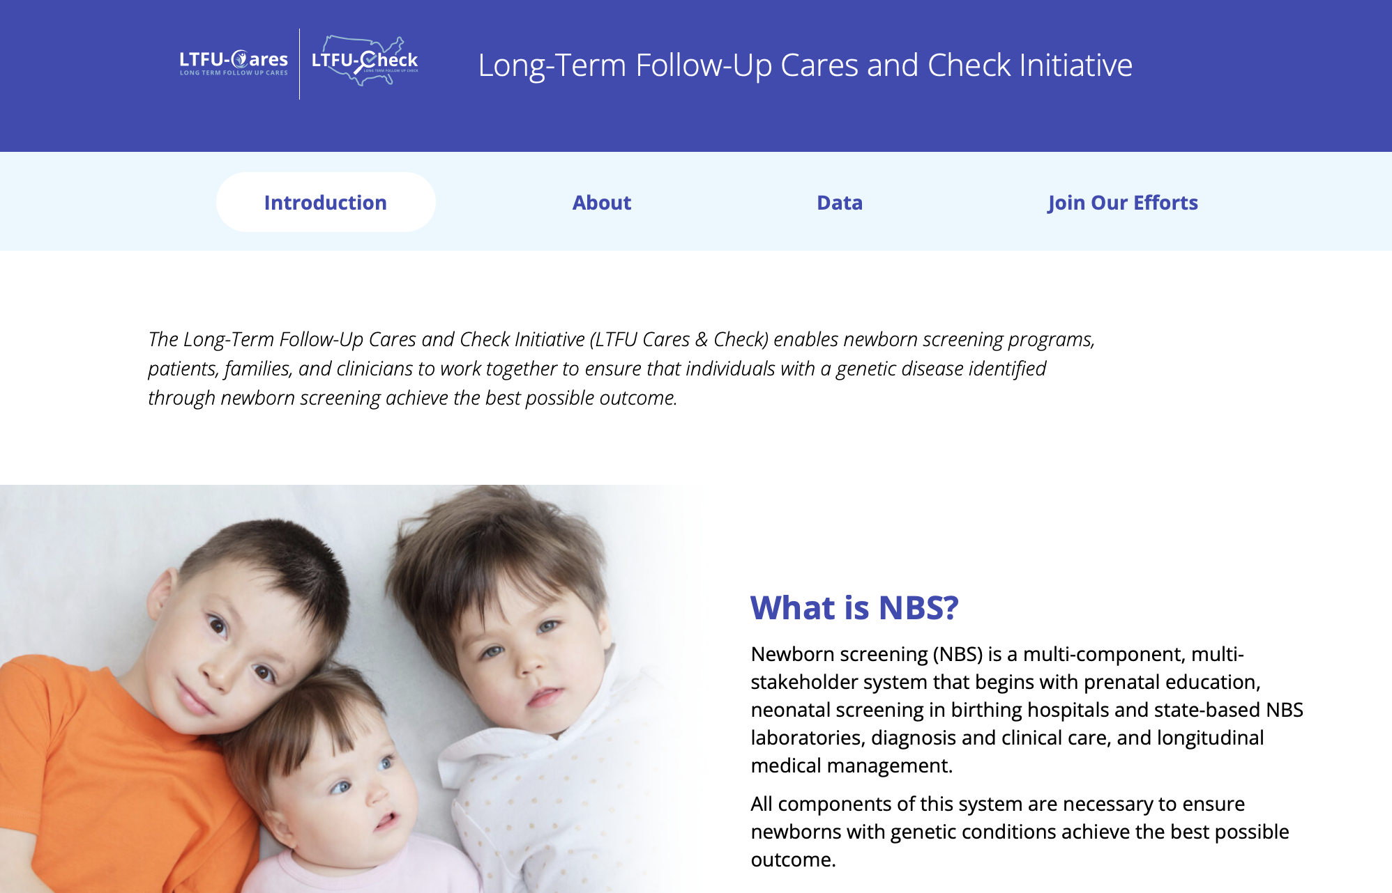
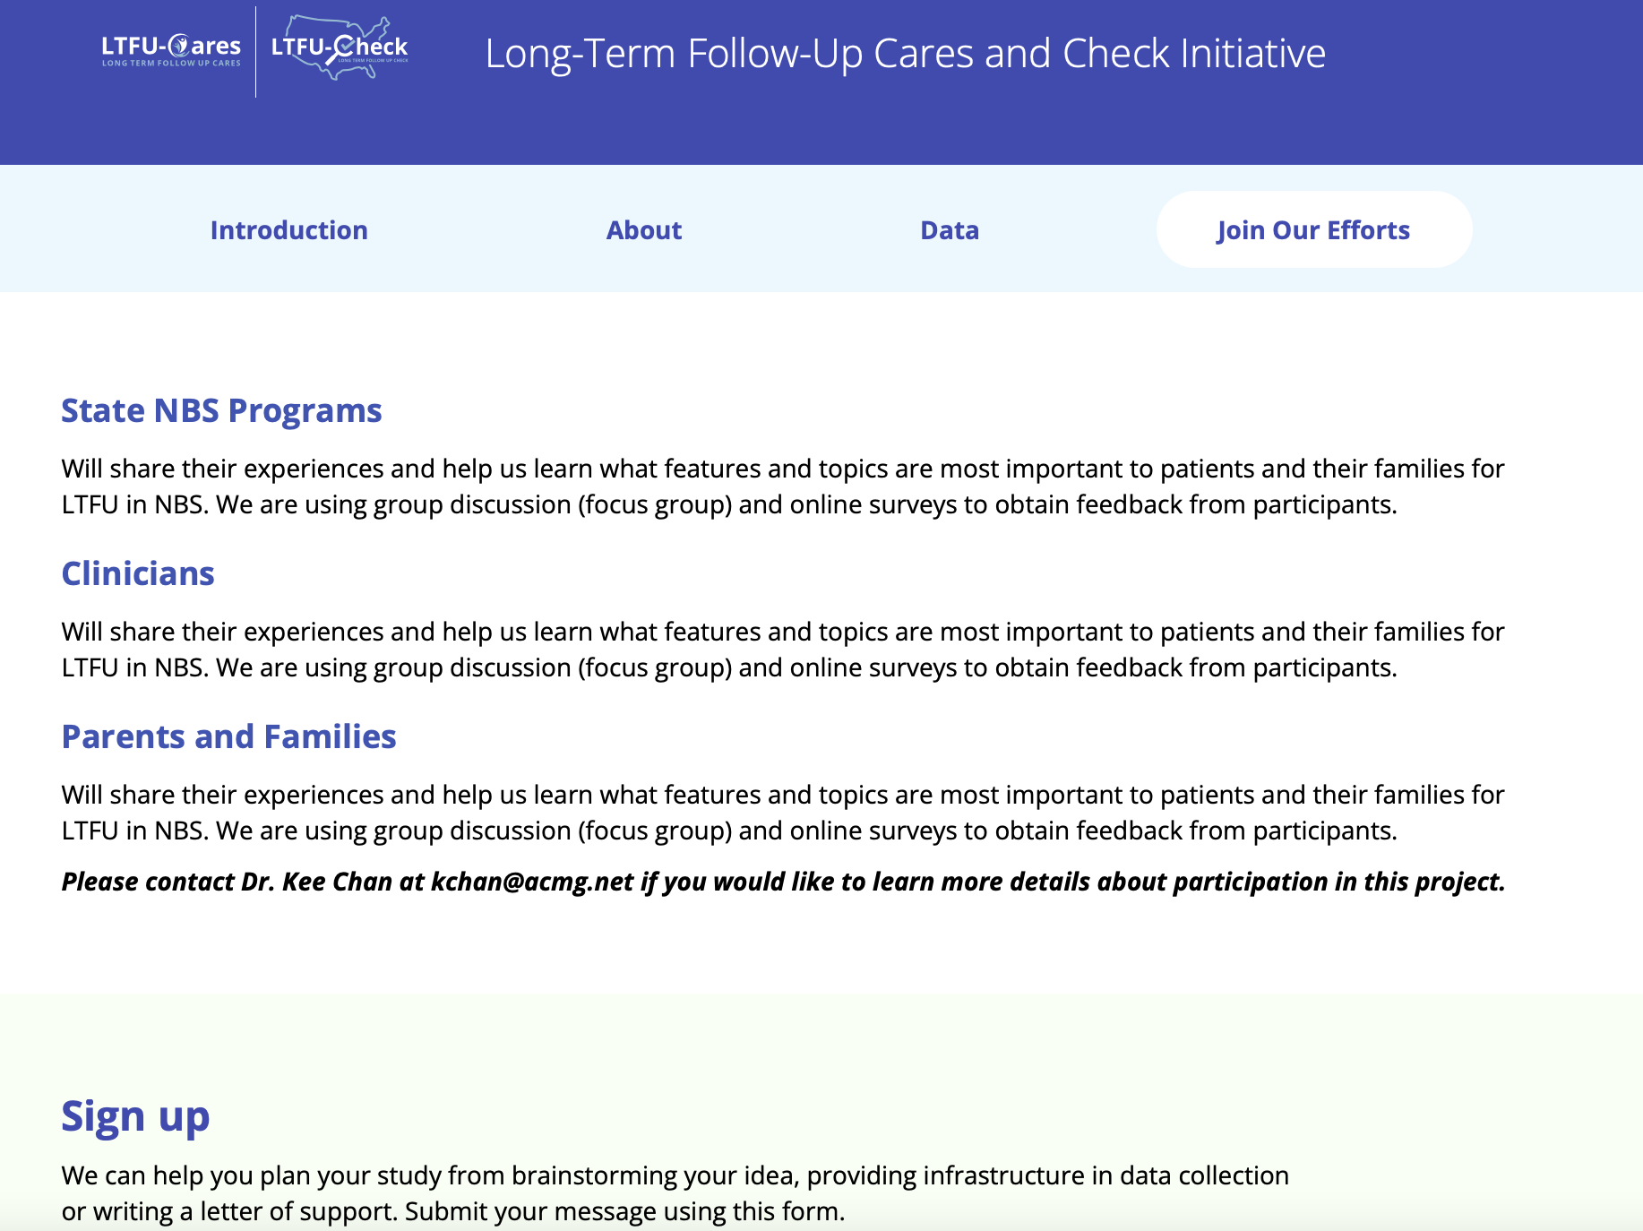
Project Website Disseminate the data on our new website: https://longtermfollowupnbs.org

Slide 18
Acknowledgment
NBSTRN Team
Amy Brower, PhD
Kee Chan, PhD, MBA
Zohreh Talebizadeh, PhD
Yekaterina Unnikumaran, MS, M.Ed
Caroline Lumpkin, MBE
LaStephanie Barnes, BS
Mei Lietsch, BS
Galata Tona, MA
Chris Pitro, MBA
Genetic Alliance
Sharon Terry, MA
Natasha Bonhomme, BA
Luna DNA
Ian Terry, BS
Clinical Partners
Emma Ciafaloni, MD, FAAN
Kathryn Swoboda, MD, FACMG
APHL
Sikha Singh, MHS
Erin Darby, MPH, MCHES
Jelili Odoju, MPH

